Slide 1



Inspiring Innovative Health Solutions

Slide 2

Session 7B: Use of Health Plan Transparency Data to Radically Transform Provider Contracting
Moderator:
David V. Axene, FSA, FCA, CERA, MAAA
Presenters:
Jing Qian, ASA, MAAA
Tony Pistilli, FSA, FCA, MAAA
David V. Axene, FSA, FCA, CERA, MAAA
July 13, 2023

Slide 3
SOA Antitrust Compliance Guidelines
3

Slide 4
Presentation Disclaimer
4

Slide 5
Introductions
Three presenters
  Jing Quian, ASA, MAAA – Lewis & Ellis
  Tony Pistilli, FSA, FCA, MAAA – Axene Health Partners, LLC
  David Axene, FSA, FCA, CERA, MAAA – Axene Health Partners, LLC
Primer on provider contracting
Real examples from carrier transparency files
Strategic questions about long term implications of transparency data
Q&A

Slide 6

Provider Contracting
July 2023
Jing Qian, ASA, MAAA
Consulting Actuary
Tel: 972-850-0850
Email: Jing.Qian@lewisellis.com
6600 Chase Oaks Blvd, Suite 150 Plano, TX 75023-2383

Slide 7
Contents
Introduction
A
Charges and Discounts
B
Reimbursement Methods
C
Contract Analysis & Competitor Intelligence
D
Looking Ahead to Transparency Data
E

Slide 8
Introduction
What is provider contract? ChatGPT says:
  A legally binding agreement between a healthcare provider and a payer, such as an insurance company or a government healthcare program. The contract outlines the terms and conditions under which the provider will deliver medical services to the payer’s beneficiaries, and how the provider will be reimbursed for those services.
  Typically covers a range of topics including types of services, the fees or reimbursement rates, the quality and performance standards, requirements for claims submitting or other administrative paperwork, etc.

Slide 9
Introduction
Provider contract impacts all parties in the healthcare industry: carriers/payers, healthcare providers and consumers.
  Reimbursement rate and structure is one of the most important elements
  Critical for carriers to control the medical cost
  Critical for providers to maintain financial viability
  Directly affects the out-of-pocket cost for consumers
This discussion will focus on the fee-for-service type of contracts.

Slide 10
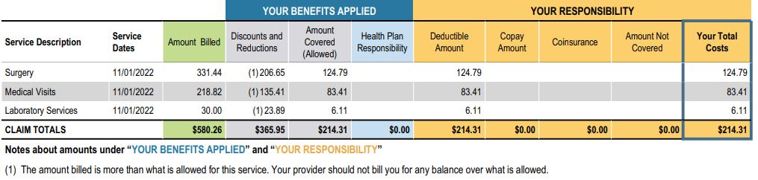
Charges and Discounts
2
1
Billed Charge ¹
Discounts & Reductions
Allowed Amount ²

Slide 11
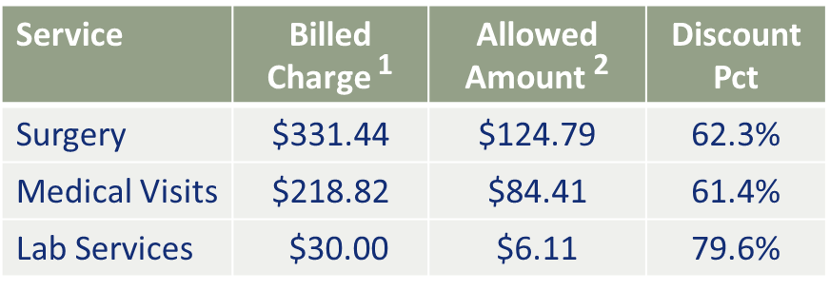
Charges and Discounts
Is the Allowed Amount supposed to be certain percentage of the Billed Charge?
  Not necessarily
How was the Allowed Amount determined?
  It depends on the reimbursement method

Slide 12
Reimbursement Methods
Professional
Outpatient
Inpatient
DRG Rate
Per Diem
Stop-loss Protection
Percent of Charge
APC Rate
Bundled Payment
Rate by CPT or HCPCS
Notes:
APC – Ambulatory Payment Classifications by CMS (similar concept as DRG for inpatient)
Same procedure could have very different rates at hospital vs. ASC
Physician rate differs by facility vs. office setting. CMS Physician Fee Schedule Lookup Tool is available to public.

Slide 13
Contract Analysis
A key input for the unit cost trend development
Widely used in
  contract rate negotiations between carriers/payers and providers
  carriers/payers’ provider network modeling such as building narrower networks, including/excluding providers based on rates
Often involves large volume of claims data and relies on assumptions of future distribution of services
Who typically perform the analysis?
  Health actuaries and healthcare analytics professionals

Slide 14
Competitor Intelligence
Contract rates are hidden information that are valuable to both carriers and providers.
Discount Analysis
  Measures the reduction from billed charges
  Requires access to claims data from multiple carriers
COB Analysis
  Usable data is often limited
Benchmark Medicare rate

Slide 15

Looking Ahead: Transparency Data
Is Transparency Data the ultimate solution for contract negotiation?
How would consumers benefit from Transparency Data?

Slide 16
Payer Transparency Files
Presented by:
Tony Pistilli, FSA, MAAA, CERA, CPC
Consulting Actuary
Axene Health Partners, LLC

Slide 17
CMS Transparency Initiatives
Hospital Transparency => Billed Charges & Cash Pay Amounts
  January 1, 2021
  “Comprehensive machine-readable file with all items and services”
Health Plan Price Transparency => Allowed Amounts
  July 1, 2022 (after delays)
  “Rates for all covered items and services between the plan or issuer and in-network providers”
  Prescription drugs are included but currently delayed pending rulemaking
  Penalty for non-compliance payable by plan sponsor
“Machine-readable”
  Hospital files had no prescribed format, which left several questions open for interpretation:
    How do you categorize items that do not have unique billing codes (e.g. transplant items)?
    What file format do you use (e.g. CSV, JSON, XML, etc.)?
    What level of granularity is required?
  Payer Transparency has standard file format that answers most questions

Slide 18
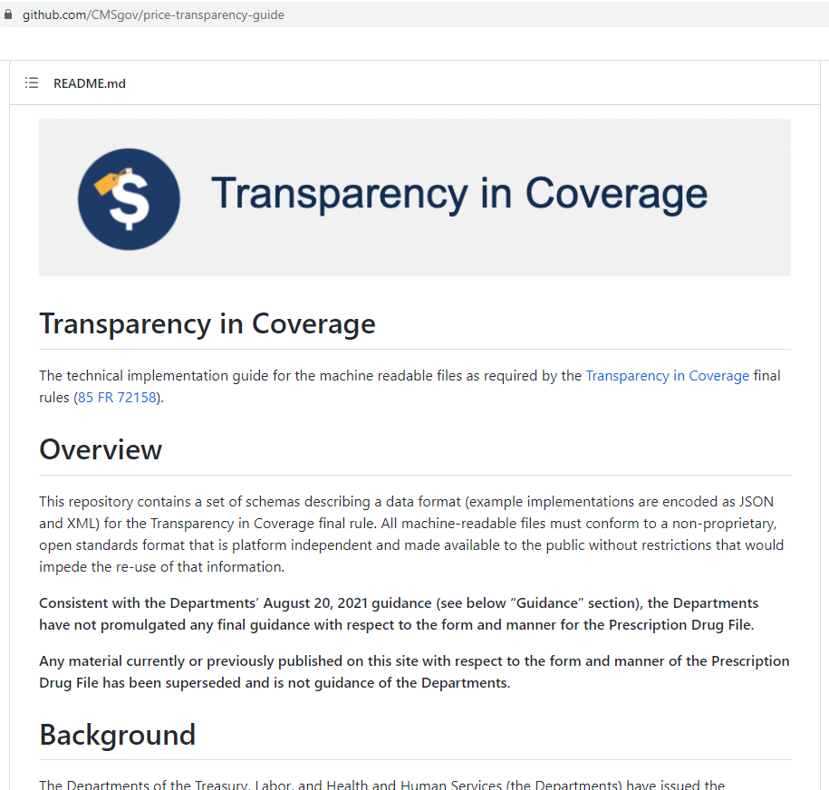
Payer Files Layout
Github Page: https://github.com/CMSgov/price-transparency-guide
File Naming Conventions
Standardized Schema
  Nested file structure
  Required and optional field designations
  Defined list of allowed values (e.g. negotitated_type = “negotiated”, “derived”, “fee schedule”, “percentage”, or “per diem”)
  In-Network and Out-Of-Network

Slide 19
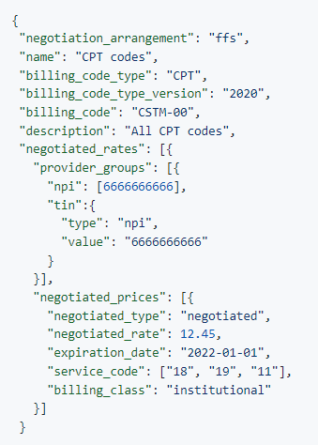
JSON Format
Accommodates nested structure very well (efficient file size)
Easy to standardize file format and validate
Cannot query in a traditional way (nested structure)
Header
General Plan Information (Name, Group/Indiv, etc.)
In-Network
Negotiation Type (FFS, Bundle, Capitation)
Billing Code
Bundled Codes
Covered Services (Capitation)
Negotiated Rates
Links Rates To Providers
Provider References
Provider Group ID
NPI
TIN/TIN Type
Provider Groups
NPI, TIN, TIN/Type
Negotiated Prices
Negotiated Type (percentage, per diem, etc.)
Negotiated Rate
Service Codes
Modifiers

Slide 20
JSON -> CSV Considerations
Tools
  SAS can do it, but can hit wall with biggest files
  Python/R, two main approaches:
    “Bulk” parsing – turn JSON into nested data frames/dictionaries, then flatten those
    “Iterative” parsing – read JSON line-by-line and keep track of nested structure iteratively
Considerations For “Optimal” Setup
  RAM vs. Disk - disk is cheaper/more readily accessible
  RAM vs. CPU – maximize system resources
  Parallel Processing – “naïve” or “programmatic”

Slide 21
File Data

Slide 22
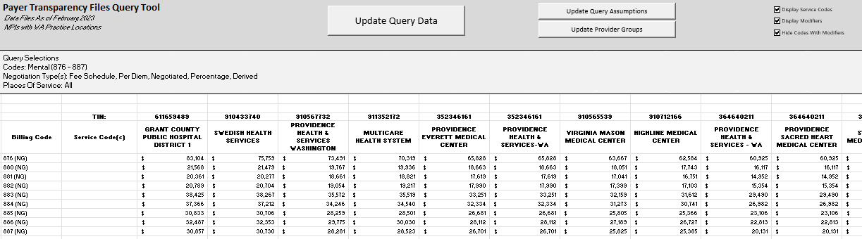
File Data

Slide 23
Current Limitations
92% of prices are “negotiation” (vs. “fee schedule”, “percent of charge”, “per diem” or “derived”)
  Several negotiated rates for same code (reflecting underlying payment policy/adjudication rules?)
  Obfuscate contract structure (percent of charge services, maternity, etc.)
Hundreds/Thousands of files per payer => difficult to navigate
  Get cryptic network plan id, but often not much else
  Some payers categorize data by employer
  Lots of duplicate data
  “Zombie” Rates
Provider data at NPI level, but contracts are likely at TIN level (or even national standard contracts)
Contract structure (i.e. DRG Base Rate, % of Medicare, etc.) hidden in detailed format
Little/no reporting of capitated agreements/VBC payments
Files update monthly; infrequent changes, but no way to know without processing

Slide 24
Strategic questions about long term implications of transparency data
Presented by:
David V. Axene, FSA, FCA, CERA, MAAA
Managing Partner & Consulting Actuary
Axene Health Partners, LLC

Slide 25
Before Transparency Data
Health plans usually understood their own contract information
Health plans didn’t have a great understanding of the competitors contracting information
  Oftentimes used COB information to draw conclusions
  Sometimes certain information was published (e.g., BCBS information)
  Occasionally gathered it from loyal providers, although limited in value
  Many times learned the most from anecdotal information from networking discussions
Significant resources expended in contracting efforts, renewing contracts, building networks, measuring performance and correcting results for bad input from above.

Slide 26
Before Transparency Data continued
Both providers and health plans are working hard to achieve their desired outcomes, many times resulting in frustration.
CMS established Medicare payment levels which form a basis for comparison of contracting results (express as % of Medicare)
Medicaid payments generally the lowest in market
Generally accepted that private systems pick up a substantial cost shift from public payment rates
Providers work hard to balance their revenue needs as part of their health plan contracting efforts
Health plans work hard to control their costs and remain competitive in the highly competitive market

Slide 27
After Transparency Data
Ideal World (assuming data accurate and complete)
  Takes away the mystery of what plans and providers are doing
  Provides opportunity to pursue best in class contracting
  Game theory suggests this knowledge will lead to a migration to a norm
  Health plans will pursue best-in-class contracting
  Providers will pursue comparable contracting compared to their peers
  Transparency itself leads to normative pricing (comparable pricing across different providers)
  Likely endpoint after market readjusts may emulate standardized pricing across providers for comparable services (i.e., by CPT, by DRG, by APC, % of Medicare, etc.)

Slide 28
After Transparency Data continued
Real World Situation
  Files are complex and are missing some key information
    stop-loss arrangements for DRG reimbursement
    Capitated reimbursement
    Alternative Payment Methods (i.e., ACOs, global payment, etc.)
  Variability by payer
  Output likely requires some creative adjustments and approaches to recognize some of the data challenges (i.e., modelling of some results)
  Carriers will be forced to using this information to gain the best market position, but it will need to be validated

Slide 29
Catalyst To Pursue All Payer System?
Could this be the catalyst to move to an all payer system?
Substantial frustration in market regarding cost shift
Will today’s public policy regarding “public discounts” survive?
Will standardization of reimbursement rates resulting from use of transparency information lead to overall market standardization?
Will it just lead to private market standardization?
Financially, a market wide payment rate close to Medicare payment levels results in budget neutral provider payments when combined with reasonable care management practices.

Slide 30
The Big Question?
Will this lead to a move to all payer?
Pros
  Reduced administrative costs (no longer need substantial staff to negotiate on both sides of the table)
  Standardized cost of care with fewer concerns about pricing levels
  Health plan performance based upon how it delivers care (care management focused)
  Provider performance based upon how it delivers care (care management focused)
  Likely lead to high performance providers and plans working together.

Slide 31
The Big Question? continued
Cons:
  Resistance to change from today’s practices
  Too much power centralized in CMS
  Loss of health plan and provider opportunity for contracting creativity
My opinion is that it is worth it to pursue. Only time will tell!

Slide 32
Q&A

Slide 33

Fill Out the Evaluation

